Slide 1





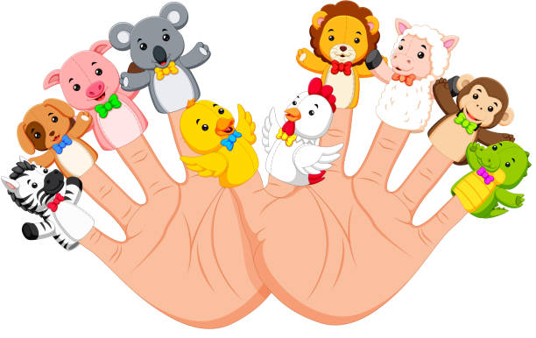

Who? Where? How Often?
I can tell you my favourite people to read with.
I can tell you where at home and school I like to share books.
I hear stories everyday and enjoy them.
What?
Learn and recite common nursery rhymes
Share traditional tales and tales with a twist
Read and hear fiction, non-fiction and poetry.
Love of Reading
What do you remember? Books? Authors?
I can tell you five nursery rhymes
I know the names of at least 3 traditional tales
I can tell you about 3 book characters and their story
I know an author writes books and an illustrator draws pictures
Making Connections
I can explain which book character I would like to be
I can talk about how books are like my experiences.
EYFS
Retelling & Building Imagination
I can draw my favourite part of a book.
Retell my story using toys, teddies, puppets and role play.
Read to my toys and teddies.
Favourites?
I can tell you my favourite story

Slide 2
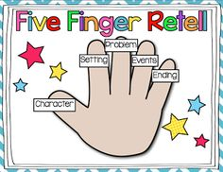
Who? Where? How Often?
I can tell you my favourite places or people to read with.
Read with a relative online or by phone
Join a library
Read for 15 minutes at least 5 times a week.
What?
I enjoy and can talk about / give an opinion of a range of texts including: fiction, non-fiction and poetry.
Love of Reading
What do you remember? Books? Authors?
List what my family enjoys reading
Name 5 book characters or stories
Draw a setting of a book
Say at least 3 poems or rhymes by heart
Talk about 3 authors
Making Connections
I can relate what I read to my own experiences.
I can talk about books with similar settings
I can say which characters are similar and different.
KS1
Retelling & Building Imagination
I can sequence or retell the main points in a story using story language, including fairy stories and traditional tales.
Retell a story with props.
Favourites?
I can recommend a book to my friends and family
I can say what I like and dislike about a book
I can talk about a favourite story, fact book or poem and say why I like it.

Slide 3

Who? Where? How Often?
Keep snuggling up and reading to my family (including my pets)
Read to a friend
Find creative places to read e.g. a den fort, in the garden.
Join the library / a book club
Read for 15 minutes at least 5 times a week
What?
Experience and discuss a wide range of texts including: fiction, non-fiction, poetry, plays, reference books and text books. Know how dictionaries and thesaurus can help. Start to read myths and legends and books from different cultures and traditions.
Love of Reading
What do you remember? Books? Authors?
I can tell you about 10 stories I have enjoyed
I can confidently discuss at least 5 authors
I can recite 5 rhymes or poems
Making Connections
I can start to talk about themes in books
Talk about how things I read compare to my own experiences
Make links between setting, characters and genres of books
LKS2
Retelling & Building Imagination
I ask questions to help me understand my books even more
I can summarise books I read
I can identify the main idea in a text
Favourites?
Create a collage of favourite things I have read.
Keep my Summerseat Super Story Checklist up-to-date with comments.
I can share opinions about books confidently and say which genres I prefer.

Slide 4

Who? Where? How Often?
Spend some time reading in every room in my house.
Ask and adult about s book they remember from school.
Create a special reading time for everyone in my home.
Read daily and for sustained amounts of time! (20 mins plus)
What?
Become familiar with and talk about a wide range of books including: modern fiction, fiction from our literary heritage, myths, legends and traditional stories as well as books from other cultures and traditions.
Love of Reading
What do you remember? Books? Authors?
I can create an A-Z of authors, characters or book titles.
I can recite my favourite poems or rhymes
Making Connections
I can rearrange my book shelf by genre, author, or book theme.
Make connections between similar texts using knowledge and personal experiences.
To compare different versions of texts talking about similarities and differences.
UKS2
Retelling & Building Imagination
I can identify significant ideas, events and characters and discus their significance.
Identify and discus themes in longer texts.
Explain the key points in a text
Summarise effectively
Favourites?
I can note everything I read on a timeline or check off the Summerseat super stories I have read.
Talk about my favourite stories with a friend.
Express a personal point of view about a text giving reasons.
Listen, respond and build on others ideas about texts. Give counter-arguments.

