Slide 1

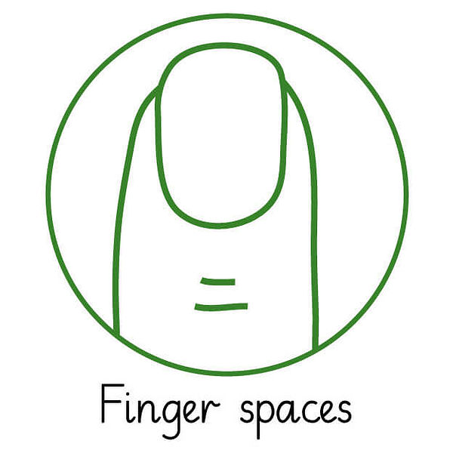
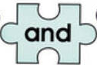

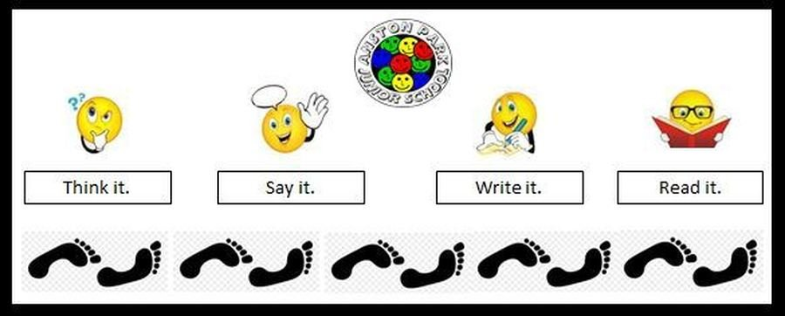


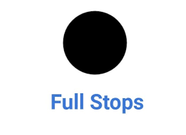
Punctuation
Capital letters (ABC): for names, the word I and at the beginning of all types of sentences
Full stops (.): used at the end of statement sentences
Question marks (?): used at the end of a question sentences
Exclamation marks (!): used at the end of exclamation sentences and to show shock or surprise
Sentence
Finger spaces: leaving spaces between words
and: joining words and joining clauses using the word and E.g. The dragon was green and fiery.
Grammar Knowledge Organiser
Terminology
Letter
phoneme
sound
capital letter
word
sentence
punctuation
full stop
capital letter
question mark
exclamation mark
singular
plural
pronoun
Word
Suffixes: that can be added to verbs where no change is needed in the spelling of root words.
Prefix: how the prefix ‘un’ changes the meaning of verbs and adjectives– kind-unkind, pack - unpack, tie-untie.
Singular: A singular noun names one person, place, thing or idea.
Plural: A plural noun names more than one person, place, thing or idea. E.g.-There is one lamp on my desk. There are two lamps on my desk.
Using ing, ed, er and est where no change is needed in the spelling of root words. E.g- helping, helped, helper, eating, eating, quicker, quickest.
Word Classes
Noun: A person, place or thing
Adjective: To describe a noun
Composing Sentences
Think it, say it, write it, read it.
Then, don’t forget to CHECK IT!

Slide 2
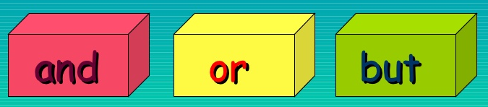
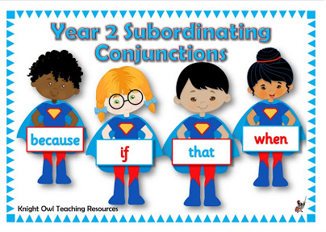

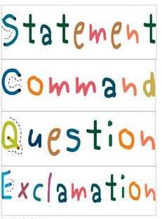

Punctuation
Capital letters (ABC): for names, the word I and at the beginning of all types of sentences
Full stops (.): used at the end of statement sentences
Question marks (?): used at the end of a question sentences
Exclamation marks (!): used at the end of exclamation sentences and to show shock or surprise
Comma (,): used in between words in a list written as a sentence and to separate clauses in sentences
Apostrophes (’): to show possession E.G the girl’s dog OR to show missing letters in contracted words e.g. I am to I’m
Sentence - Conjunctions
Conjunction: join short clauses up to make longer sentences.
Co-ordinating
Conjunctions
Grammar Knowledge Organiser
Sentence - Conjunctions
Statements tell the reader something and end with a full-stop. It is usually cold in winter.
Commands begin with a verb, tell the reader to do something and end with a full-stop.
Brush your teeth.
Questions need an answer and end with a question mark.
What did you learn at school
today?
Exclamations start with
“how” or “what”, contain a
verb and end with an
exclamation mark.
What a beautiful dress! OR
How amazing it was!
Terminology
noun
noun phrase
statement
question
exclamation
command
compound
suffix
adjective
adverb
verb
tense (past, present)
apostrophe
comma
Word Classes
Noun: Person, place or thing
Adjective: Describes a noun
Verb: Action word
Adverb: Describes the verb or adjective
Noun Phrase: A noun and the simple words that go with it in the sentence the girl OR a ball
Expanded noun phrase: A noun and adjective the little girl OR a spotty ball OR the green, scaly dragon.
Remember: Always think of a sentence before you write it down and CHECK IT!
Present tense: When something is happening now
E.G. Sam is playing football. OR Sam plays football
Past Tense: When an event has already happened
E.G Sam was playing football OR Sam played football.

Slide 3
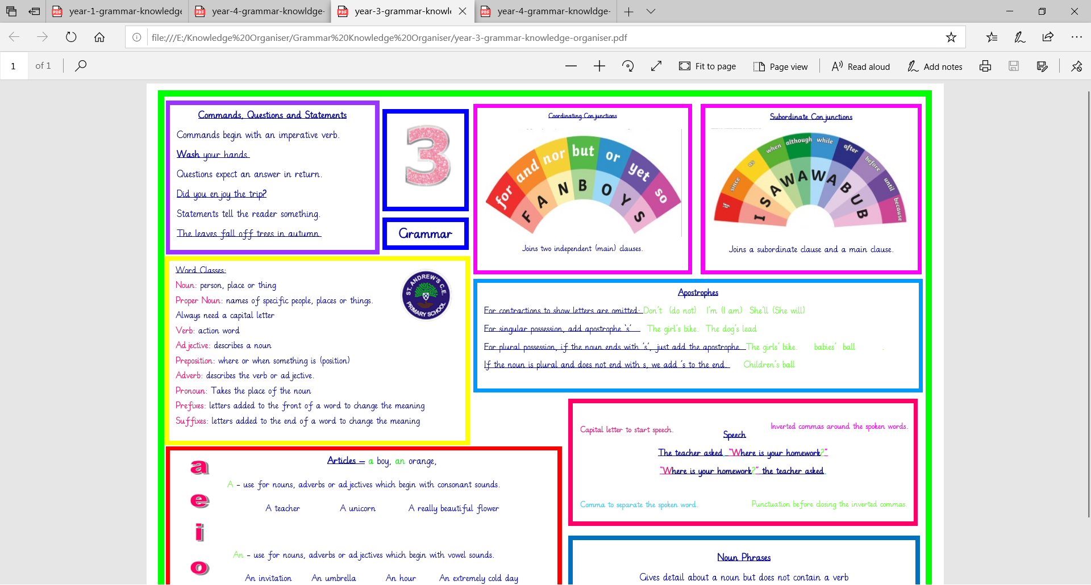


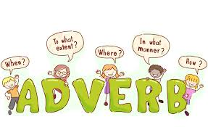
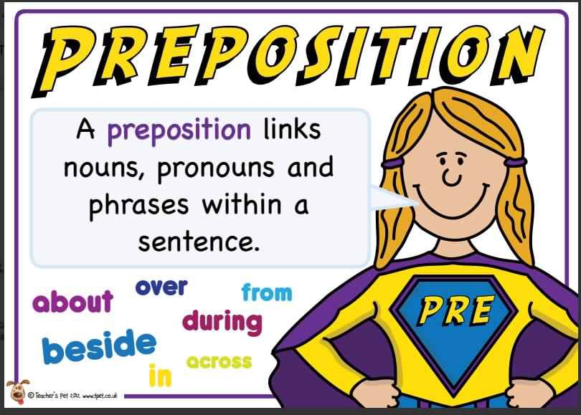
Punctuation
Don’t forget:
. ! ? , ‘
Inverted commas: To punctuate direct speech.
The teacher asked, “Where is your homework?”
“Where is your homework?” the teacher asked.
Capital letter to start speech
Inverted commas around spoken words
Commas to separate the spoken word
Punctuation before closing the inverted commas
Apostrophes:
For contractions to show letters are omitted:
Don’t (do not) She’ll (She will)
For singular possession, add apostrophe ‘s’.
The girl’s bike. The dog’s lead
For plural possession, if the noun ends with ’s’, just add the apostrophe
The girls’ bike. The babies’ ball.
If the noun is plural and does not end with s, we add ’s to the end.
Children’s ball
Sentence - Conjunctions & Adverbs
Grammar Knowledge Organiser
A
E
I
O
U
Word - Articles
A - use for nouns, adverbs or adjectives which begin with consonant sounds.
A teacher A unicorn A really beautiful flower
An - use for nouns, adverbs or adjectives which begin with vowel sounds.
An invitation An umbrella An extremely cold day
P
A
R
A
G
R
A
P
H
S
Word Classes
Noun: person, place or thing
Proper Noun: names of specific people, places or things.
Always need a capital letter
Verb: action word
Adjective: describes a noun
Preposition: where or when something is (position)
Adverb: describes the verb or adjective.
Pronoun: Takes the place of the noun
Prefixes: letters added to the front of a word to change the meaning
Suffixes: letters added to the end of a word to change the meaning
Terminology
Preposition, conjunction, word family, prefix, clause, subordinate clause, direct speech, consonant, consonant letter vowel, vowel letter, paragraph
inverted commas (or ‘speech marks’)

Slide 4

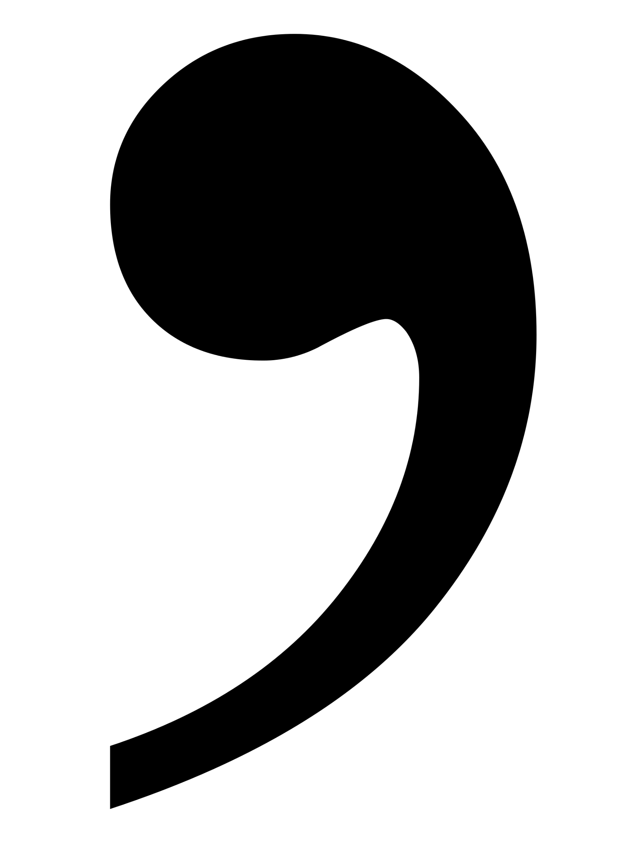
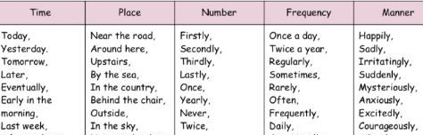
Punctuation
Don’t forget:
. ! ? , ‘
Inverted commas: To punctuate direct speech.
The teacher asked, “Where is your homework?”
“Where is your homework?” the teacher asked.
Capital letter to start speech
Inverted commas around spoken words
Commas to separate the spoken word
Punctuation before closing the inverted commas
Apostrophes:
For omission: Don’t (do not) She’ll (She will)
For singular possession, add apostrophe ‘s’: The girl’s bike. The dog’s lead.
For plural possession, if the noun ends with ’s’, just add the apostrophe: The girls’ bike. The babies’ ball.
If the noun is plural and ends with an s, we attach the apostrophe to it without an additional s: babies’ ball, Davies’ house.
If the noun is plural and does not end with an s, we add s to the end: Children’s ball
Sentence - Conjunctions
P
A
R
A
G
R
A
P
H
S
Grammar Knowledge Organiser
Terminology
determiner
pronoun
possessive pronoun
adverbial
Sentence – Fronted Adverbials
Remember: Proof read for spelling, punctuation & grammar
Choose your pronoun carefully to aid cohesion and avoid repetition.
Expanded Noun Phrases
Expand with the use of modifying nouns, adjectives and prepositional phrases.
The teacher (noun phrase) becomes …
The strict maths teacher with curly hair.
An ancient book in a leather sleeve was hidden in the library.
Word Classes
Noun: person, place or thing
Proper Noun: names of specific people, places or things.
Always need a capital letter
Verb: action word
Adjective: describes a noun
Preposition: where or when something is (position)
Adverb: describes the verb or adjective.
Pronoun: Takes the place of the noun
Prefixes: letters added to the front of a word to change the meaning
Suffixes: letters added to the end of a word to change the meaning
Word
Determiners: A word before a noun and identifies the noun in further detail.
Articles: a boy, an orange, the cat Demonstratives: this apple, that car, these shops, those girls Possessives: his hat, her homework, my book, their house.
Quantifiers: some rice, each word, every box
Numbers: one chair, two men, three dogs
Question Words: which bag, what letter, whose computer

Slide 5
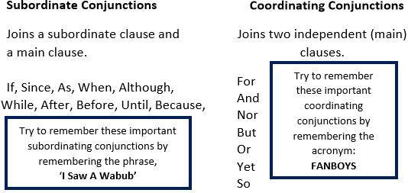

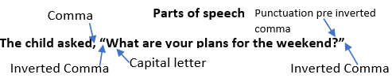
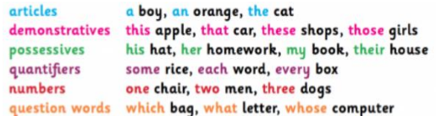
Punctuation
Remember: . ! ? , ‘ “”
Apostrophes:
For possession: Shows us that something belongs to the subject, e.g. My Mum’s bag.
Take care when using apostrophes with plurals, e.g. the pupils’ coats. (More than one pupil has a coat)
For omission: Shows us that a letter has been missed out to create informality, e.g. Do not do that = don’t do that.
Hyphen (-) – Creates compound words to give a clear meaning.
The man-eating shark.
The man eating shark.
Colon(:) – Introduces a list or separates two main clauses when the second explains or describes the first clause.
Semi-colon(;) – joins two related independent clauses together
Dashes (–), brackets (), commas (,) Used within a sentence to add additional information - Parenthesis The cat (that didn’t belong to me) was black.
Grammar Knowledge Organiser
Sentence
Terminology
modal verb relative pronoun
relative clause
parenthesis bracket
dash
cohesion
ambiguity
Noun phrases
Gives detail about a noun but does not contain a verb.
An ancient book in a leather sleeve was hidden in the library.
Commands, Questions, Statements & Exclamations
Commands - begin with an imperative Verb, e.g. Wash your hands.
Questions - expect an answer in return. e.g. Did you enjoy the trip? Statements - tell the reader something. e.g. The leaves fall off trees in autumn.
Exclamations – Must start with a How or What, e.g. What an amazing piece of work!
Rules of Speech
Comma
-Clarify meaning
-Avoid ambiguity
Cohesion
Words which link paragraphs
e.g. then, after that, this, firstly, then, later, next, following this
Determiners
A word before a noun and identifies the noun in further detail.
Clauses
Main clause – A simple sentence that contains a subject and a verb. It makes sense on its own, e.g. I went to school
Subordinate clause – Contains a subordinating conjunction. Adds detail to a main clause; is not a full sentence. The subordinate clause can appear at the start, end or middle of a sentence, e.g. I went to school while my brother stayed at home.
Relative Clause – Type of subordinate clause, beginning with a relative pronoun or an omitted relative pronoun.
Relative Pronouns = who, which, where, when, whose, that
Parenthesis
Parenthesis – add extra information inside dashes (–), brackets () or commas (,)
E.g. Brasilia (the capital city of Brazil) has a population of 2.4 million.
Summerseat Methodist Primary School, located in Summerseat, has the best teachers in the country.
Modal Verbs
Indicates degree of possibility: might, should, will, must, ought, could, often, can
Preposition
Indicate position of a noun in a sentence, e.g. over, by, under, along, for, down, through and in.

Slide 6
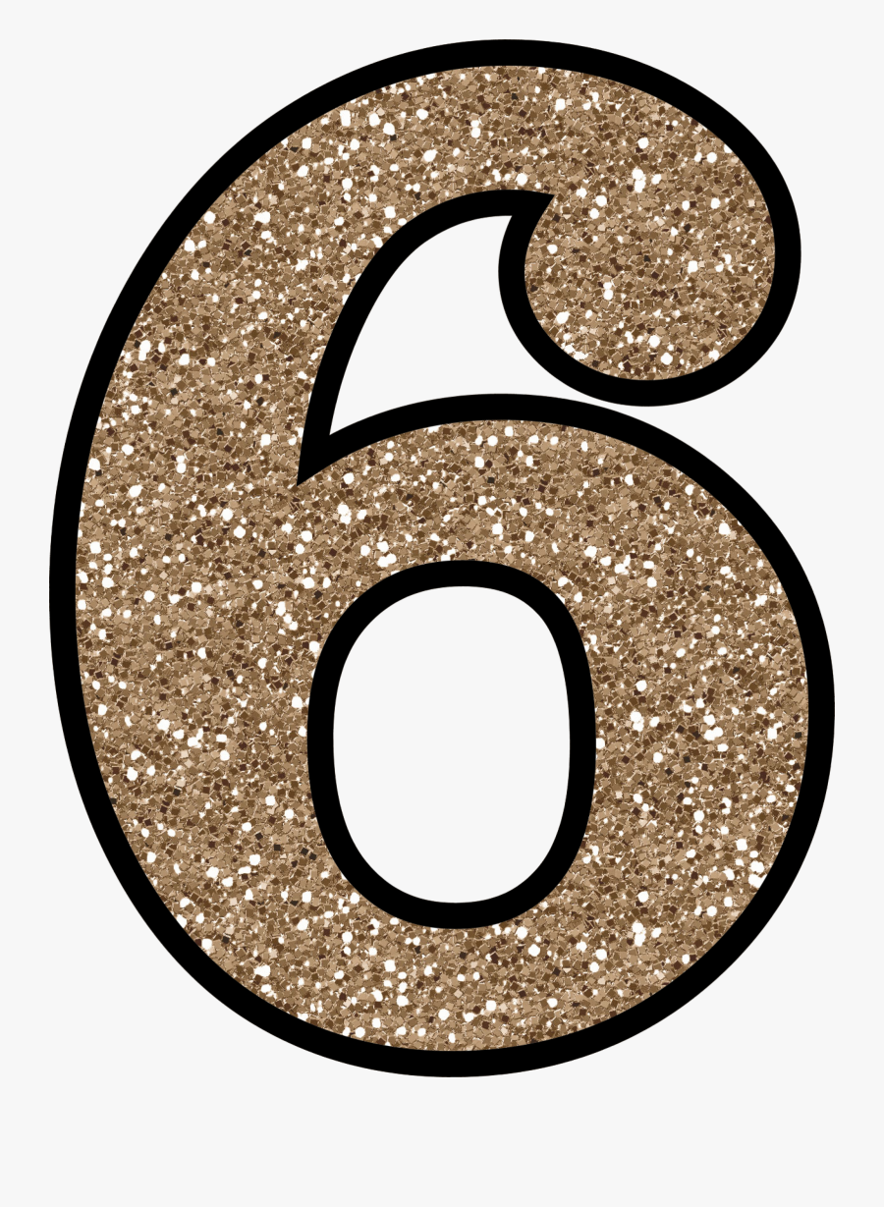
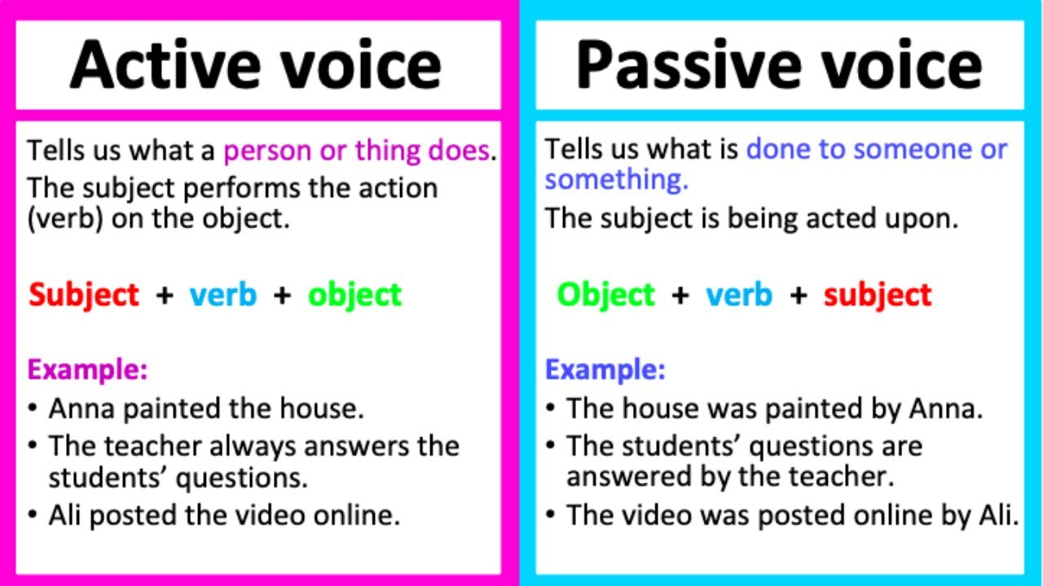
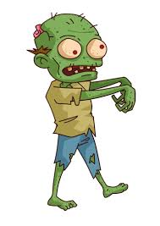
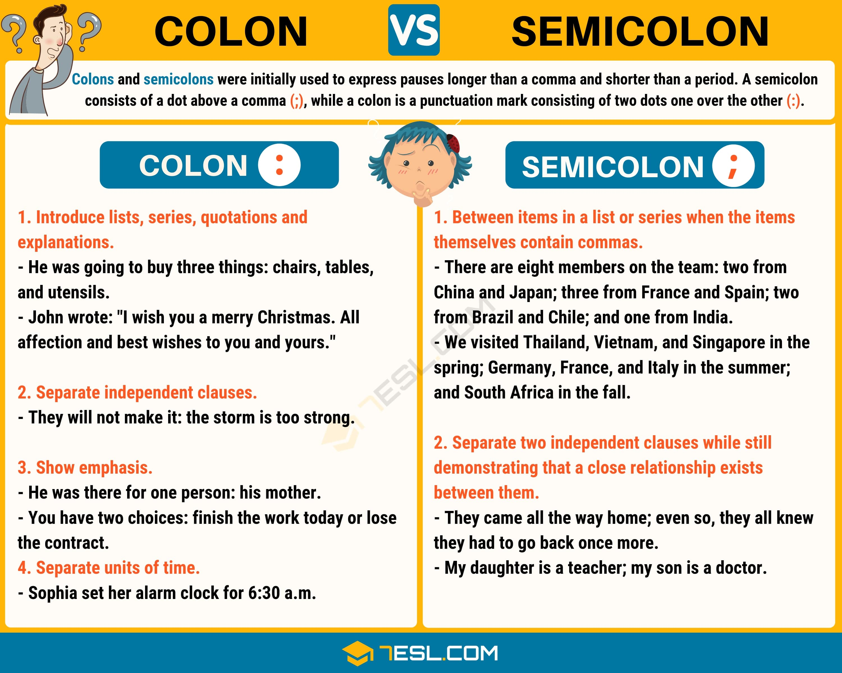
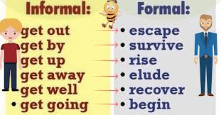
Punctuation
Remember: . ! ? , ‘ “”
Apostrophes:
For possession: Shows us that something belongs to the subject, e.g. My Mum’s bag.
Take care when using apostrophes with plurals, e.g. the pupils’ coats. (More than one pupil has a coat)
For omission: Shows us that a letter has been missed out to create informality, e.g. Do not do that = don’t do that.
Hyphen (-) – Creates compound words to give a clear meaning.
The man-eating shark.
The man eating shark.
Colon(:) – Introduces a list or separates two main clauses when the second explains or describes the first clause.
Semi-colon(;) – joins two related independent clauses together
Dashes (–), brackets (), commas (,) Used within a sentence to add additional information - Parenthesis The cat (that didn’t belong to me) was black.
Grammar Knowledge Organiser
Passive & Active
Active – Subject performs the action.
Passive – When the subject has something done to it.
If you see ‘by someone’ or can add by zombies to the end and the sentence and it makes sense you know it is written in the passive voice.
Terminology
subject
object
active
passive
synonym
antonym
ellipsis
hyphen
colon
semi-colon
bullet points
Comma
-Clarify meaning
-Avoid ambiguity
Modal Verbs
Indicates degree of possibility: might, should, will, must, ought, could, often, can
Clauses
Main clause – A simple sentence that contains a subject and a verb. It makes sense on its own, e.g. I went to school
Subordinate clause – Contains a subordinating conjunction. Adds detail to a main clause; is not a full sentence. The subordinate clause can appear at the start, end or middle of a sentence, e.g. I went to school while my brother stayed at home.
Relative Clause – Type of subordinate clause, beginning with a relative pronoun or an omitted relative pronoun.
Relative Pronouns = who, which, where, when, whose, that
Cohesive Devices
-Repetition of a word or phrase
-Adverbials: on the other hand, in contrast, as a consequence, following this, later -Ellipsis …
Subjunctive form or mood
A verb form to express wishes, hopes, commands, demands or suggestions.
If I were the prime minister…
Were they to come …
Formal Vs Informal
The level of formality of a piece of writing depends on the audience and purpose.
Use of:
-Contractions
-Abbreviations
-Chatty tone
-Question tags
Use of:
-Subjunctive
-Technical & precise vocab

