Slide 1

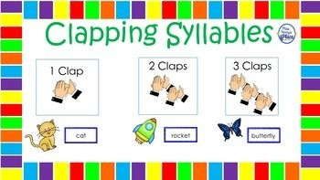
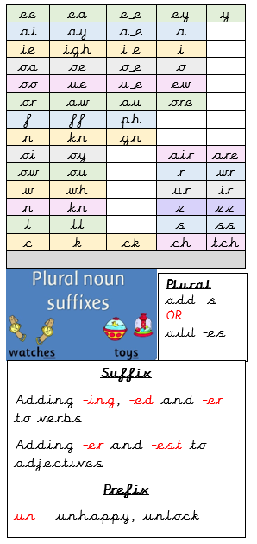

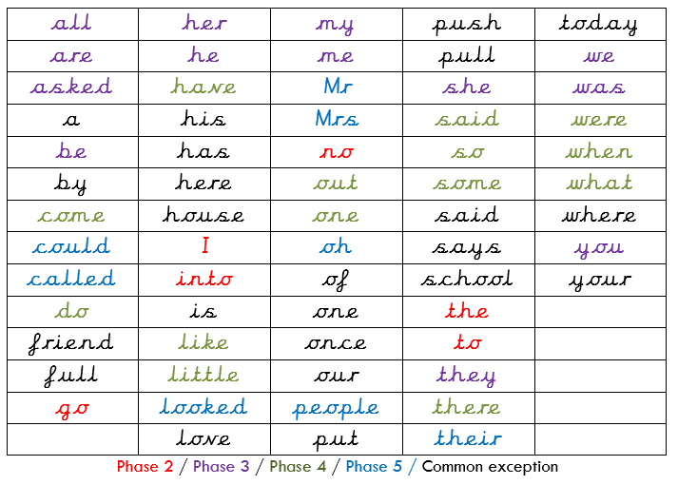
A
B
C
D
E
F
G
H
I
J
K
L
M
N
O
P
Q
R
S
T
U
V
W
X
Y
Z
a
b
c
d
e
f
g
h
i
j
k
l
m
n
o
p
q
r
s
t
u
v
w
x
y
z
Spelling Knowledge Organiser

Slide 2
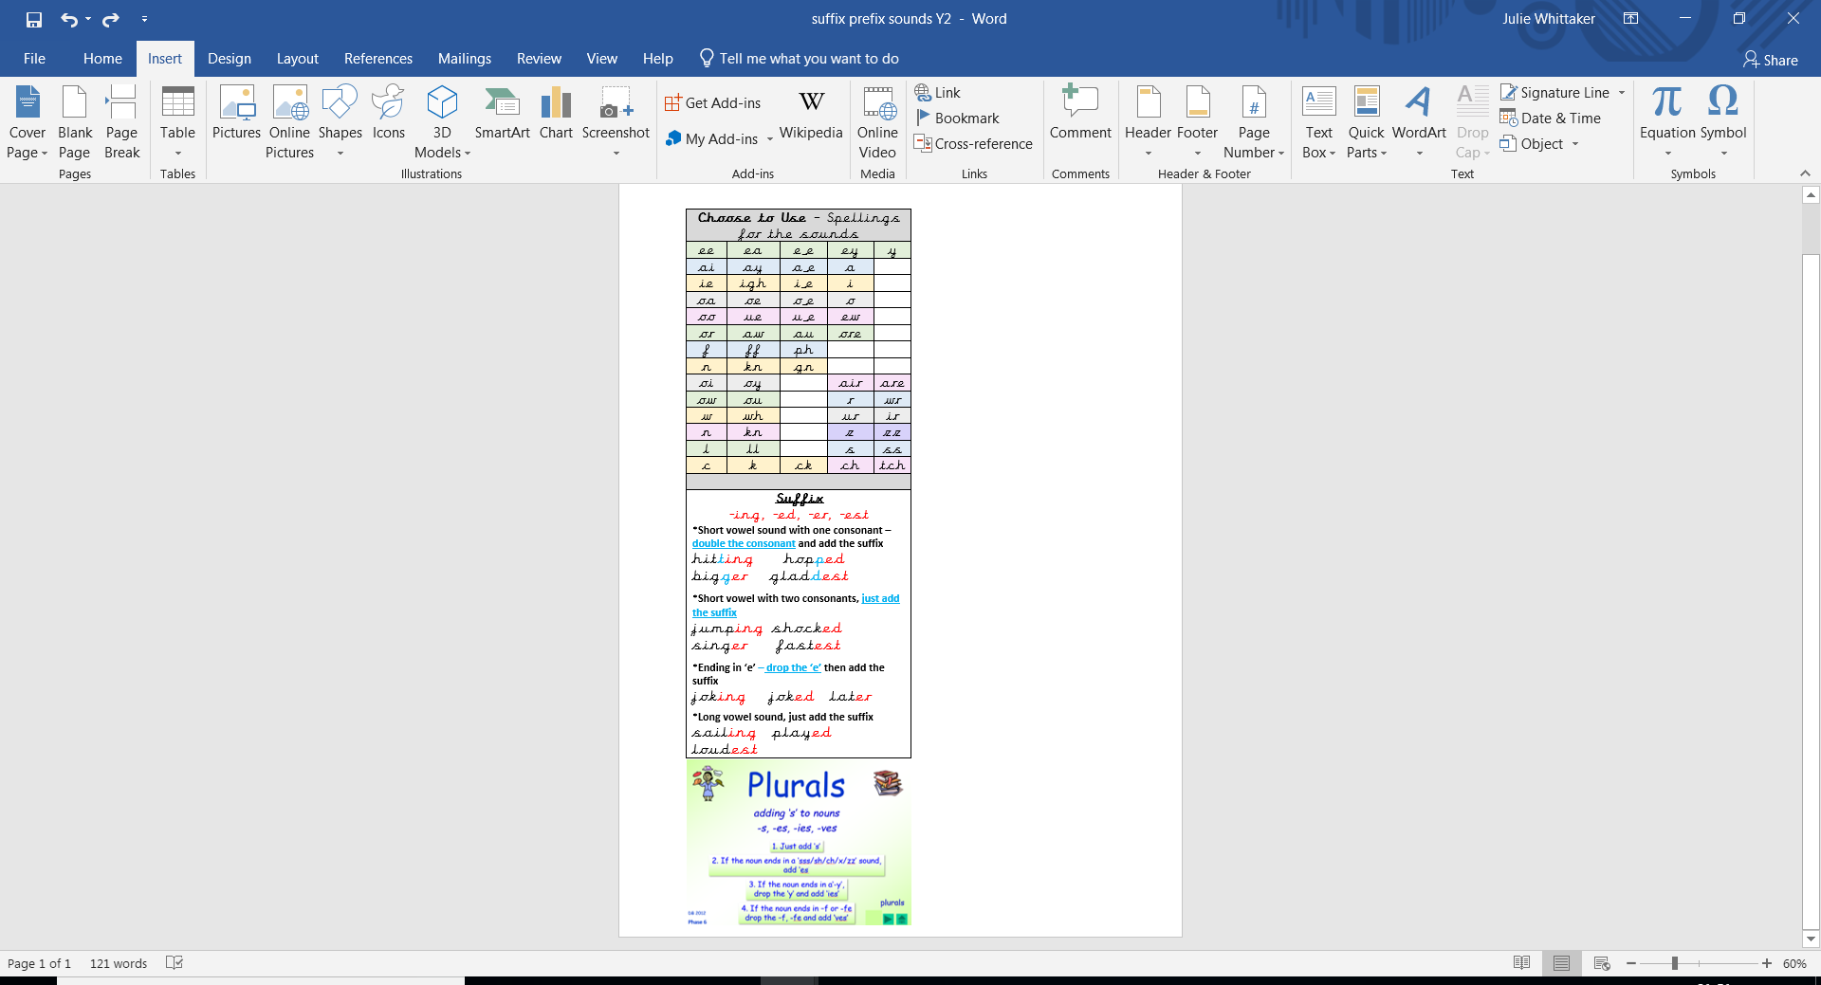


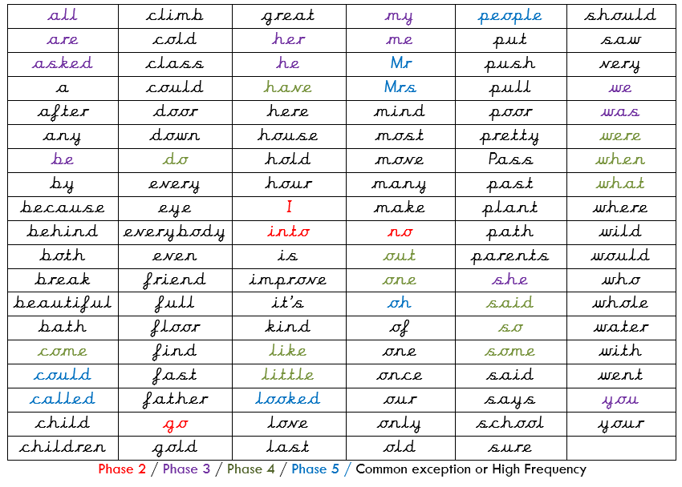
A
B
C
D
E
F
G
H
I
J
K
L
M
N
O
P
Q
R
S
T
U
V
W
X
Y
Z
a
b
c
d
e
f
g
h
i
j
k
l
m
n
o
p
q
r
s
t
u
v
w
x
y
z
Spelling Knowledge Organiser
Vowel
Consonant
contraction
Homophone
The suffixes –ment, –ness, –ful , –less and –ly
- If a suffix starts with a consonant, it is added straight onto most root words without change.

Slide 3
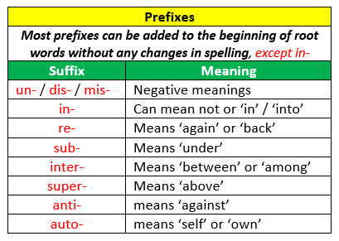

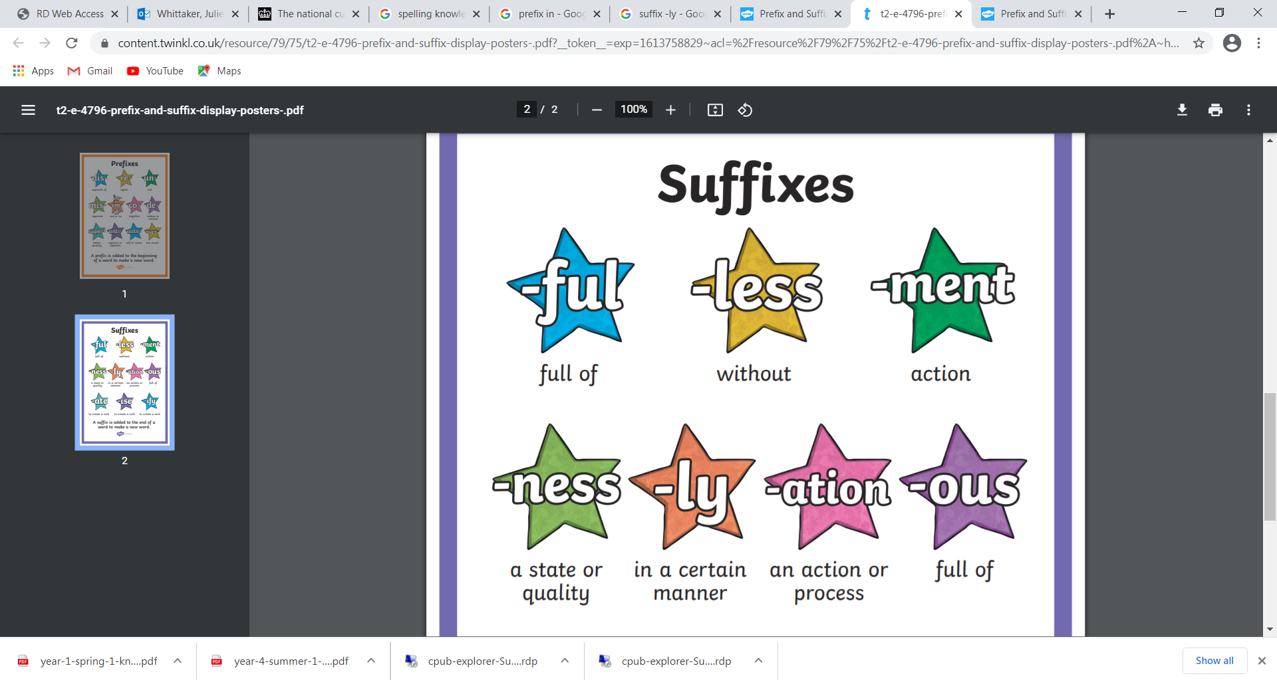

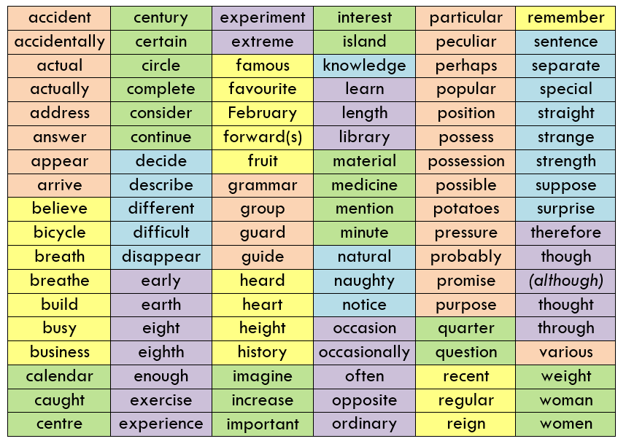
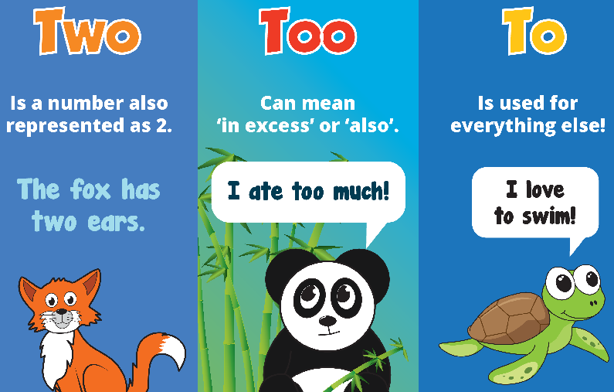
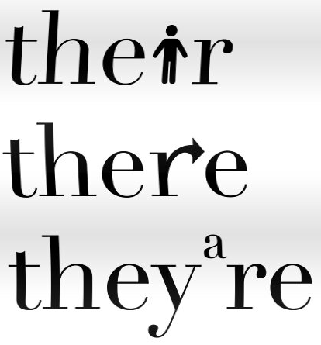
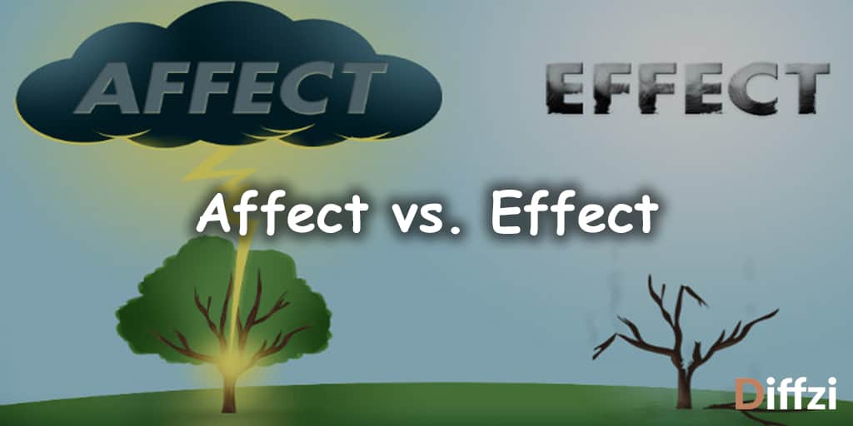
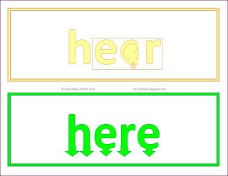
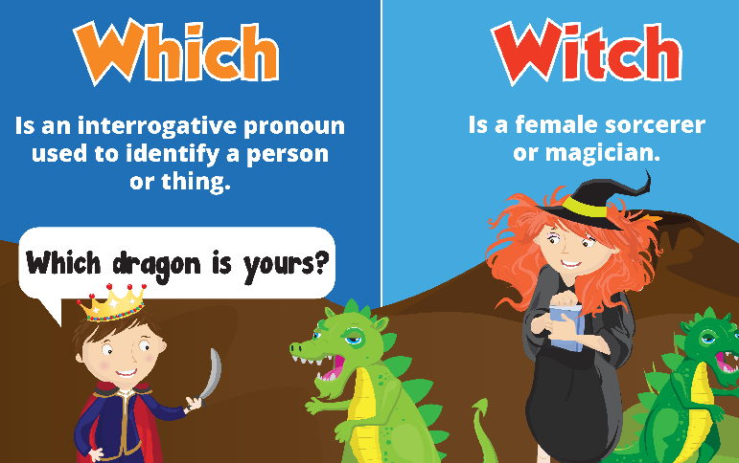
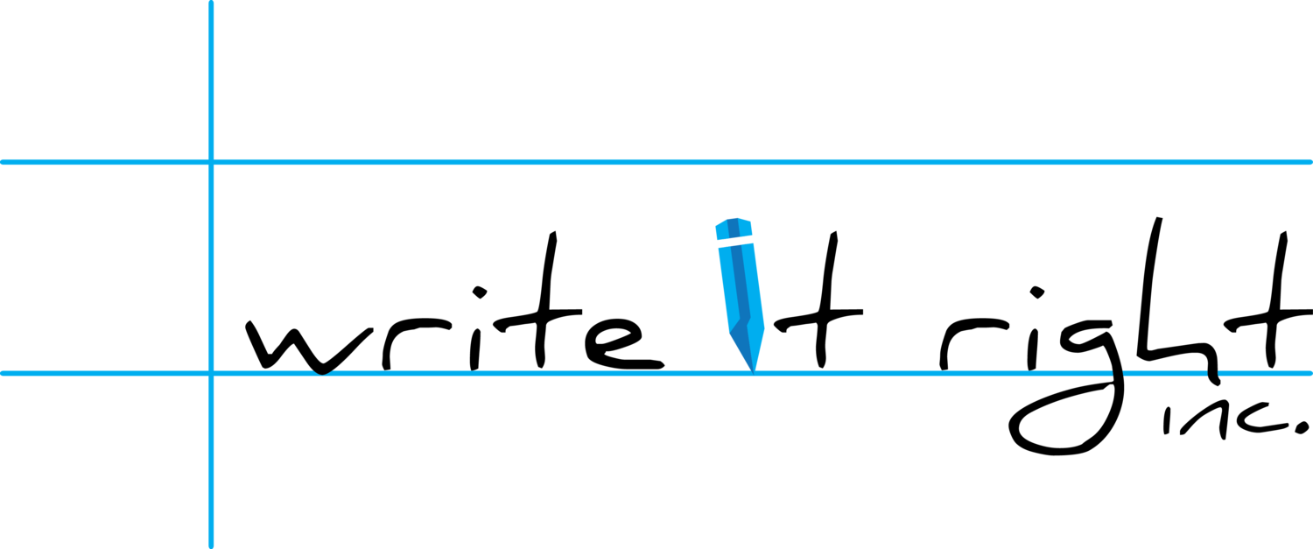
Spelling Knowledge Organiser
&
in-
Before a root word starting with l, in– becomes il
illegal, illegible
Before a root word starting with r, in– becomes ir–. irregular, irrelevant
Before a root word starting with m or p, in– becomes im
immature, immortal
Homophones

Slide 4

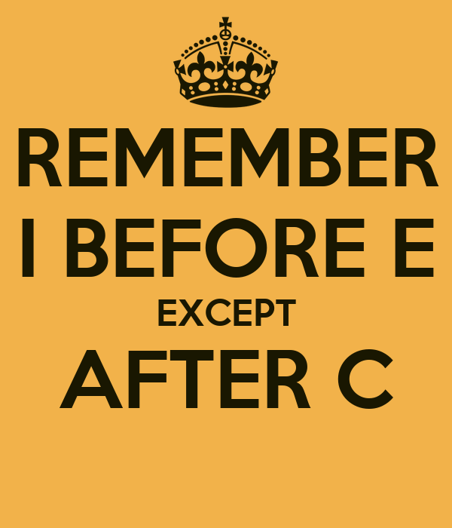
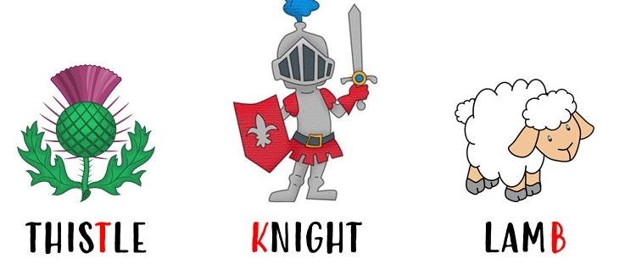

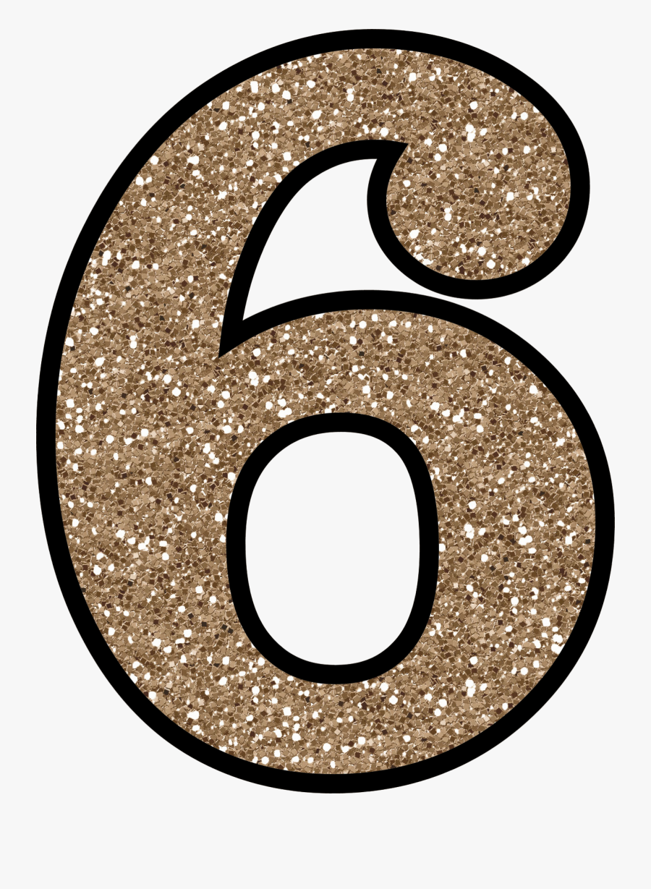
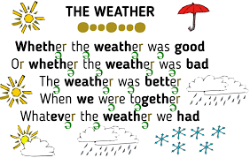

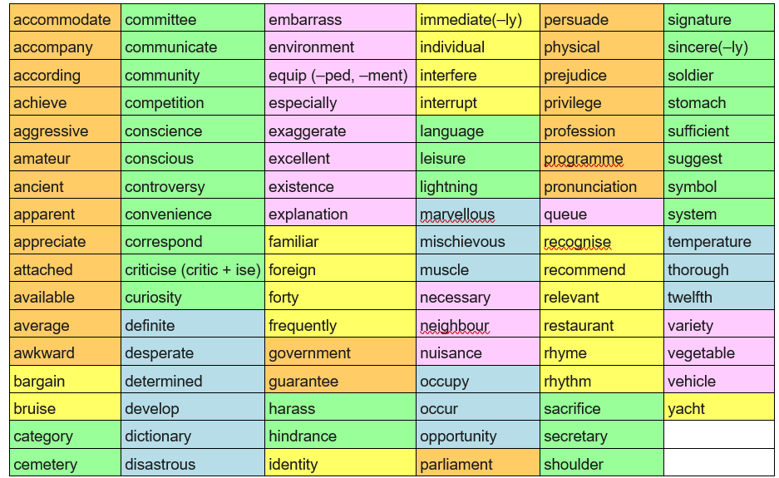

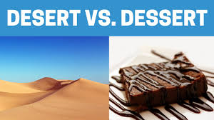
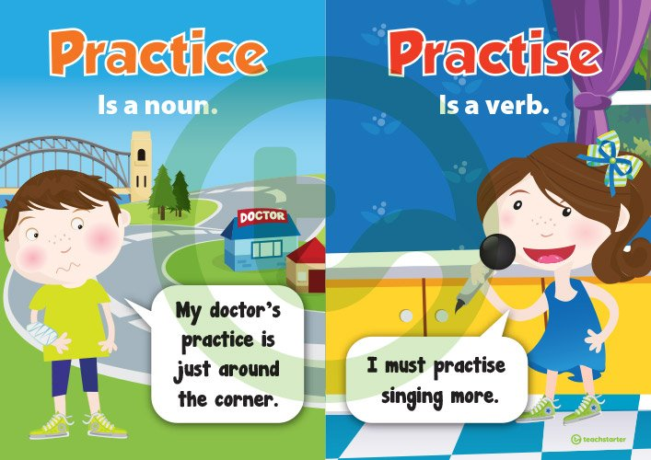
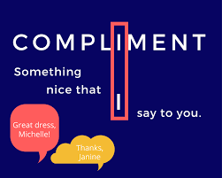
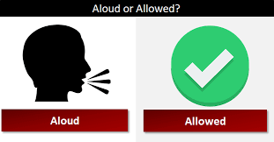
Spelling Knowledge
Organiser
Words ending:
-cious, -tious, -cial, -tial
-ant, -ance, -ancy,
-ent, -ency, ence
-able, -ible, -ably, -ibly
-fer
Silent Letters
&
Homophones

Slide 5


