Slide 1



Summerseat Methodist Primary
Reading Strategy

Slide 2
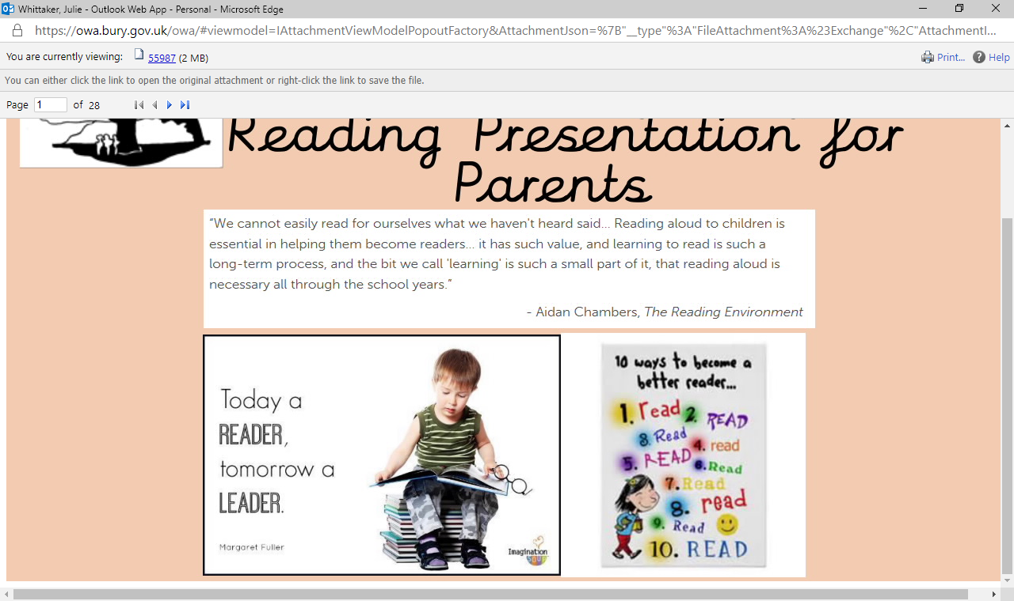

Some thoughts …

Slide 3


Our Reading Strategy
Without the ‘thrill’ there is no ‘will’ to engage. If children don’t engage then they will never acquire the ‘skill’.
Alistair Bryce-Clegg
will

Slide 4

Thrill
Developing a Love of Reading
The importance of daily reading cannot be emphasised enough.
Creating a love of reading in children is potentially one of the most powerful ways of improving academic standards.
There can be few better ways to improve pupils chances in school, or beyond in the wider world than to enable them to become truly independent readers.

Slide 5
Thrill
Developing a Love of Reading in school
Daily storytime across school - builds on core texts used in English (Diversity / cultural capital)
Books as hooks across the curriculum
Stories embedded in collective worship
Summerseat Super Stories – high quality recommended reads in each class (currently Y3-Y6)
Author of the month / visiting authors
Outdoor reading sheds
Reading for pleasure as part of guided reading rotations
Reading for pleasure book to go home each week (KS1, then super stories)
Development of reading

Slide 6
Thrill
Developing a Love of Reading at home
Read to your child often – please record this in reading diaries
Create a ‘cosy’ feel when your read – make reading a lovely memory
Don’t push your child to learn to read - Most children learn to read naturally once they develop the preliminary skills. Your goal is not to help him sound out words, but to encourage a love of books, both pictures and stories.
Don’t stop reading to your child once they can read
Read books beyond those that your child could read independently
Alternate pages as your read
Visit the library regularly
Read a range of texts – stories, poetry, non-fiction, comics, magazines

Slide 7




Will
Developing the will to learn in school
Classrooms are full of books – indoors and outdoors
Class reading areas are full of books that children have already encountered and had positive experiences with
There is a wide range of texts available across a range of interests – fiction, non-fiction, poetry, magazines, comics, audio books
Rewards for reading – praise, stickers, house points, dip tubs (+ other in class rewards)
Reader of the week (Book reward)

Slide 8
Will
Developing the will to learn at home
Fill your child’s room with books
Be a good reading ‘role model’ for your child
Introduce books that match your child’s hobbies and interests
Pick engaging and funny books
Look at series
Enjoy audio books
Offer a reading reward

Slide 9


Skill – EYFS / KS1
Developing Reading Skills in school
Comprehension
Decoding
(Phonics and Word Recognition)
The ability to understand the meaning of the words and sentences in a text
The ability to understand the ideas, information and themes in a text
The ability to recognise sounds (phonemes)
The ability to blend letter sounds (phonemes) together to read words
The ability to recognise words in and out of context
Our primary focus in the early years and KS1 is developing decoding skills so that children can be come confident and fluent readers.

Slide 10

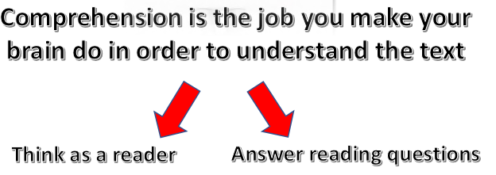
Skill – EYFS / KS1
Developing Reading Skills in school
Comprehension
Decoding
Daily 25 min phonic session
Regular opportunities to practise across the day – ‘Stop it, drop it and phonics!’
Phonics timetabled at the start of the day
Staff timetable
Bounce back - pre-teach and post-teach as needed
Phonics bands and mats
Training with Anna Lucas and Simon Hunt – Supersonic phonics friends supporting resource
Phonic assessment and tracking systems reviewed
Word Strips
Timetabled guided reading rotations throughout school
VIPERS
Cracking Comprehension

Slide 11
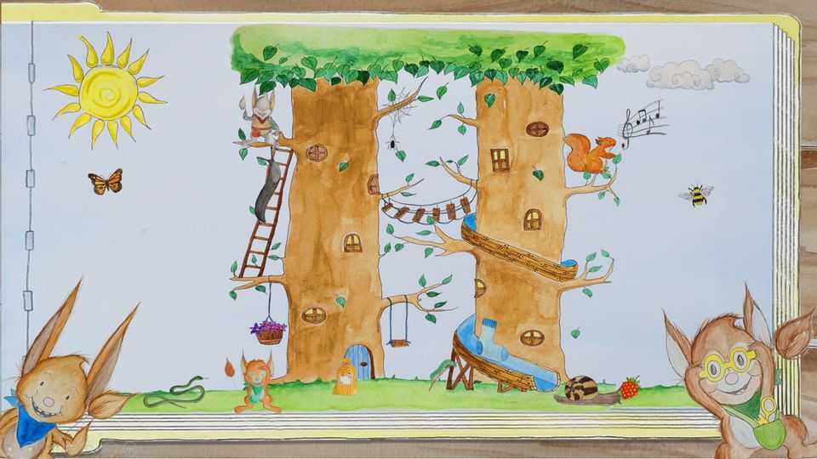
Skill – EYFS / KS1
Developing Reading Skills in school
Meet the Supersonic Phonics Friends …
Developed by Anna Lucas and Simon Hunt to support effective teaching of systematic Synthetic Phonics
Ensures a consistent and engaging approach across school

Slide 12
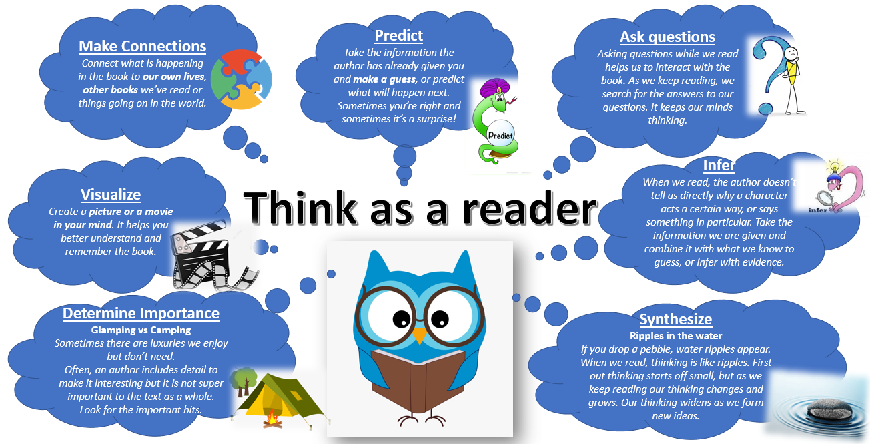
Skill – EYFS / KS1

Slide 13
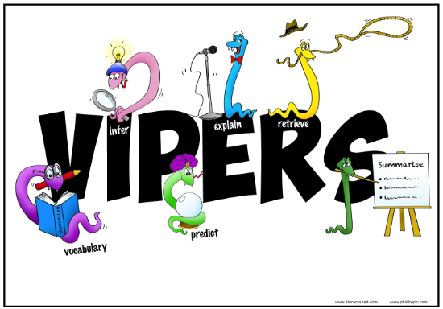
Skill – EYFS / KS1
Developing Reading Skills in school
Our primary focus in the early years and KS1 is developing decoding skills so that children can be come confident and fluent readers. In Year 2, children will start to meet our VIPERS.

Slide 14

Skill – KS2
Developing Reading Skills in school
Comprehension
Decoding
(Phonics and Word Recognition)
The ability to understand the meaning of the words and sentences in a text
The ability to understand the ideas, information and themes in a text
The ability to recognise sounds (phonemes)
The ability to blend letter sounds (phonemes) together to read words
The ability to recognise words in and out of context
Our primary focus in the early years and KS1 is developing decoding skills so that children can be come confident and fluent readers. In KS2 the focus gradually turns to comprehension.

Slide 15
Skill – KS2
Developing Reading Skills in school
Comprehension
Decoding
Regular opportunities to practice phonics for those children who still need it.
Bounce back - pre-teach and post-teach / phonics intervention as needed
Training with Anna Lucas and Simon Hunt – Supersonic phonics friends supporting resource (New for 2020)
Phonic assessment and tracking systems reviewed
Focus on word strips
No Nonsense Spelling continues phonics and spelling in KS2
VIPERS approach to support understanding of range of question types
Timetabled guided reading rotations throughout school
Cracking Comprehension

Slide 16
Skill – KS2

Slide 17
Skill – KS2
Developing Reading Skills in school
Our primary focus in the early years and KS1 is developing decoding skills so that children can be come confident and fluent readers.

Slide 18

Skill – EYFS / KS1
Developing Reading Skills at home
Foster the love of reading
Make sure your child reads regularly to practise the skill and develop their stamina
Practise key word and phonic strips
Use the ‘Think as a reader’ strategy
Use the VIPERS book marks to help with questioning (Y2)

Slide 19


Books at Home – EYFS / KS1
Reading for Success
Reading for Pleasure
This book is to celebrate what your child is able to read independently and is closely matched to their work in phonics lessons. They should be able to read it to you, mostly independently.
This book is for you to read and enjoy with your child. At Summerseat, we see that reading for pleasure has a dramatic impact on educational outcomes, mental wellbeing and is also a magical experience in itself.
2 books per week – one reading for success, one reading for pleasure
Reading for success books are available to use digitally so if we have to use our remote learning policy, these titles will be set by staff
Please feel free to supplement reading for pleasure with books from home

Slide 20
Word Strips
To support us at home in ensuring children build on the reading skills they are developing in class, you will receive word strips. These will be either: to practise reading words containing a specific phonic sound, or to practise reading common exception words (tricky words).
Please spend a few minutes each morning, or evening, working on reading these words.
If it is a phonic strip, encourage your child by saying, “If in doubt sound it out” or “If you see a word that you cannot muster, who you gonna call, the blending busters.” These are phrases we use at school so may prompt your child.
The common exception words are words we aim to read by sight. Many of them are words that cannot be sounded out but even if they can, they are high frequency words that children ought to read on sight.

Slide 21
Word Strips
Look at the letters that make up the word and discuss the tricky parts. Then move onto looking at the shape the word makes.
Use them as flashcards and see how quickly you can read them. Can you beat your time as you do it again?
Turn all the cards face up. Ask your child to close their eyes as you remove one. Can they say which word has gone?
Look for your key words in your reading book. How many times can you find……..?
We will regularly check your child’s reading of these words as part of our reading time in class.
You may repeat word sets at different times in the year as children can forget them and so we often repeat them.

Slide 22
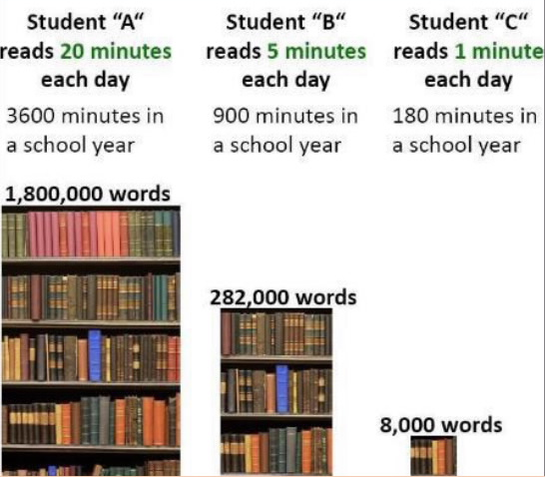
Final Thought …
Reading widely and often increases pupils’ vocabulary because they encounter words they would rarely hear or use in everyday speech. Reading also feeds pupils’ imagination and opens up a treasure-house of wonder and joy for curious young minds.
DfE Programmes of English Key Stage 1 & 2

